Slide 1
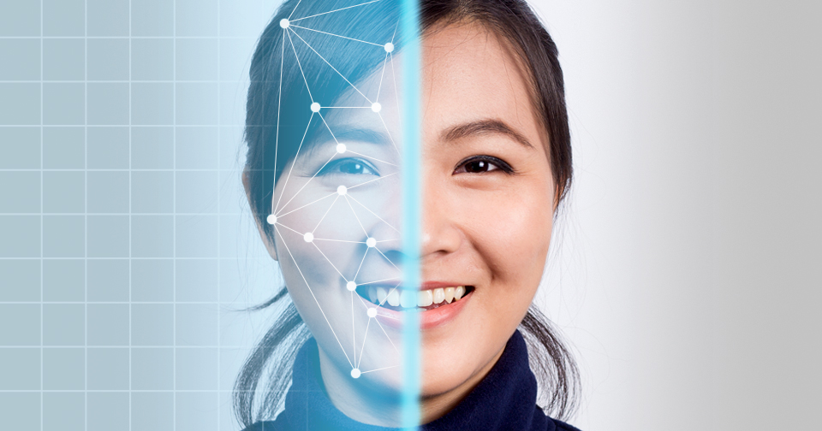
Face Detection and Emotion Recognition
By Yamini Pathuri
Instructor: Dr. Jiayin Wang
Course: CSIT 697 Masters’ Project Montclair State University, NJ
Figure is from google search

Slide 2
Special Thanks to the committee members Dr. Jiayin Wang, Dr. Michelle Zhu, Dr. Boxiang Dong

Slide 3
Approach:
Data Collection
Model training
using CNN
SGD , Adam
optimizers
OpenCV
References
Conclusion/
Future work
Demo of the
Output
Results

Slide 4
contd..
In this project, my approach is to develop a reliable and accurate system for face detection and emotion recognition, Where I have used Convolutional Neural Network (CNN) for the model training . After training the model, it is integrated with the OpenCV. In OpenCV the face can be detected and the emotions can be displayed. Additionally, recognized emotions can be heard.

Slide 5
Data Description:
The data set that can be used in this project is taken from the public resource called Kaggle. This dataset has both train and validation data. The training data has seen different classes such as happy, sad, angry, disgust, neutral, surprise, fear. Similarly, the validation has seven different classes, they are happy, sad, angry, disgust, neutral, surprise, fear.

Slide 6
Literature Survey:
In this paper [1], the author propose a novel feature dual-channel expression recognition based on machine learning theory and emotional philosophy. Because features extracted using CNN ignore subtle changes in the active regions of facial expressions the proposed algorithm first path takes the Gabor feature of the ROI region as input. This author used the dataset FER 2013 and obtained accuracy of 74%.

Slide 7
contd..
This paper [2], presented the research on FER, allowed us to know the latest developments. The author described different architectures such as CNN and CNN-LSTM recently proposed by different researchers, and presented some different database containing spontaneous images collected from the real world and others formed in laboratories, in order to have and achieve an accurate detection of human emotions.

Slide 8
contd..
Author uses the classification algorithms used in conventional FER include SVM, Adaboost, and Random Forest, by contrast, deep learning-based FER approaches highly reduce the dependence on face physics based models. In [3] after implementing the above mentioned classifiers the overall accuracy obtained is 73%.

Slide 9
Methodology:
Convolutional Neural Network (CNN)
In face detection, CNN will analyze images by progressively learning intricate facial features through convolutional layers. These networks enable automatic feature extraction and localization, allowing them to identify faces within images using learned patterns, resulting in accurate and efficient detection.
CNN plays a pivotal role in emotion recognition by processing facial expressions through layers that capture features like eyes, nose, ears, forehead, mouth. These networks learn to differentiate emotions, allowing them to categorize faces into emotional states with a high degree of precision.

Slide 10
Stochastic Gradient Descent (SGD) in CNN
SGD is a widely used optimization algorithm in training neural networks, including CNNs. It is particularly useful when dealing with large datasets because it updates the model's parameters based on small random batches of data rather than the entire dataset.
SGD features are almost similar to the Adam Optimizer features, but there is one drawback that made Adam Optimizer better is at first time learning if it faces any misdetection it will ignore that completely. But in facial detection process we shouldn’t miss a single thing.

Slide 11
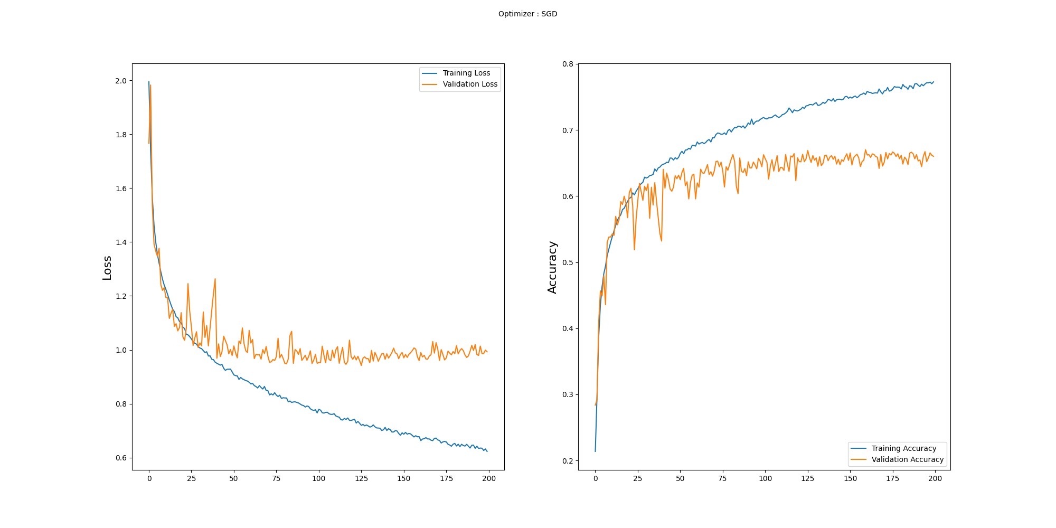
Fig1: SGD Optimizer accuracy

Slide 12
Adam Optimization in CNN
Adam (Adaptive Moment Estimation) is a popular optimization algorithm that combines the advantages of both SGD and adaptive learning rate methods. It adapts the learning rate for each parameter individually based on past gradients and squared gradients.
Adam is mainly preferred because when it validates the dataset, there are less chances of getting errors.
And if we are planning to take more epochs then it is better to use Adam than SGD.

Slide 13
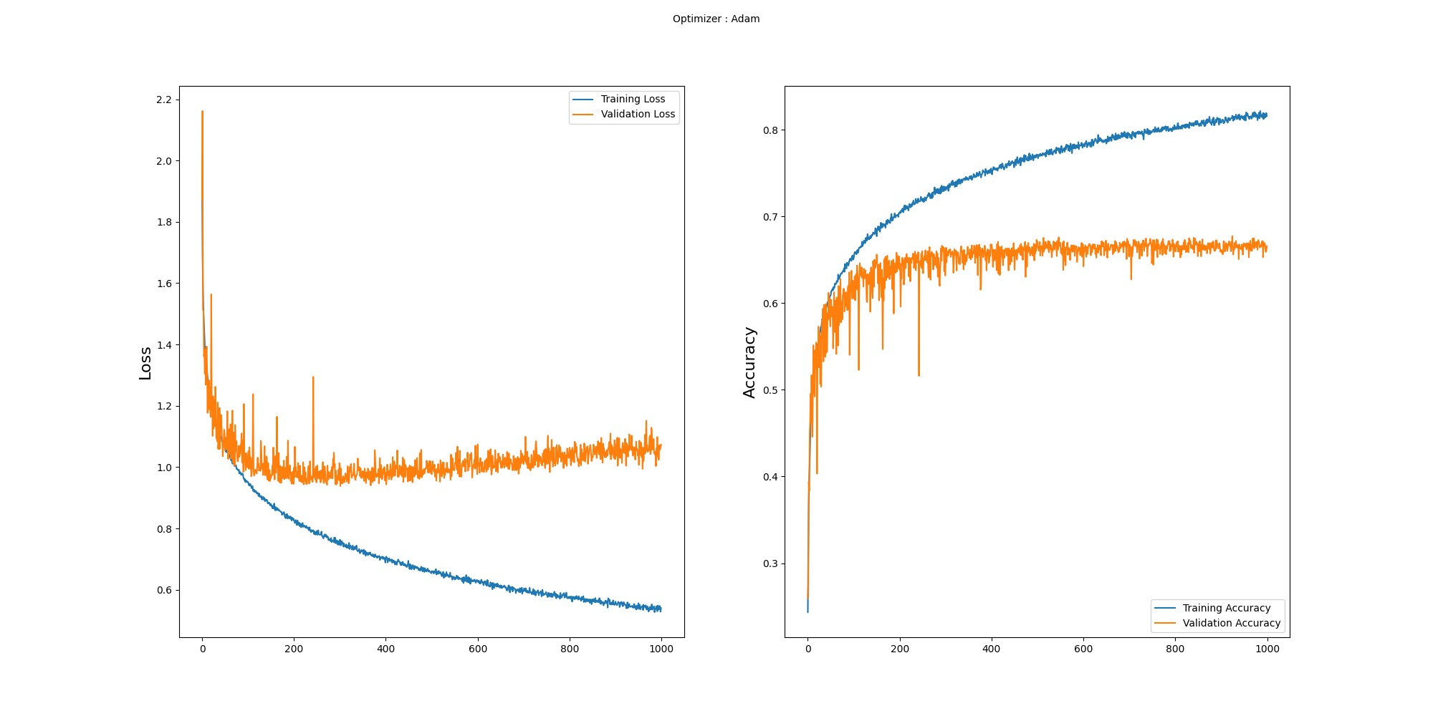
Fig2: Adam Optimizer accuracy

Slide 14
Open CV
OpenCV (Open-Source Computer Vision Library) is a widely used open-source library for computer vision tasks, especially for face detection and emotion recognition.
OpenCV is an indispensable tool for integrating face detection and emotion recognition functionalities into applications.
Leveraging OpenCV's Haar cascades or deep learning models, it swiftly identifies faces in images or real-time video streams.
By incorporating its image processing capabilities and pre-trained models, OpenCV empowers people to accurately recognize facial expressions and emotions, making it a vital component for creating interactive and emotionally-aware systems.

Slide 15
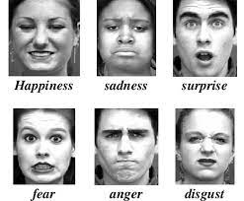
Expected Results:
Fig3: Expected Results Figure is from google search

Slide 16
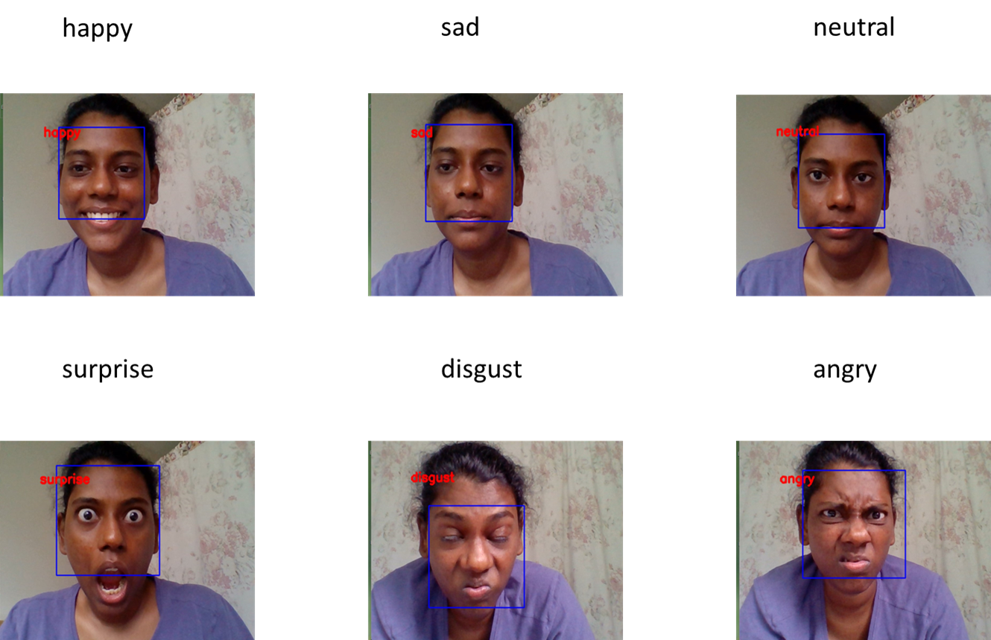
Results:
Fig4: Obtained Results

Slide 17
Results contd..
Optimizers | Accuracy | Epochs
SGD | 0.772 | 120
Adam | 0.816 | 1000
Table 1:Results of both the optimizers

Slide 18

Demo

Slide 19
Conclusion:
In conclusion, choice between Stochastic Gradient Descent (SGD) and Adam optimization for training Convolutional Neural Networks (CNNs) is a critical decision that significantly impacts the model's performance. While both optimizers contribute to efficient convergence and parameter updates, my experimentation demonstrates that Adam consistently outperforms SGD in terms of accuracy.
In scenario where accuracy is important, my findings strongly recommend for the adoption of Adam as the preferred optimization algorithm. The performance gains achieved by leveraging Adam's adaptability, efficient memory usage, and hyperparameter optimization underline its suitability for pushing the boundaries of accuracy in CNN.

Slide 20
Future Work:
Collecting the real time images of a person, in order to obtain better accuracy.
It is always limited to learning only the six-basic emotion plus neutral. It conflicts with what is present in everyday life, which has emotions that are more complex. The future work is to build larger databases and create powerful deep learning architectures to recognize all basic and secondary emotions.
Moving from 2D images, 3D facial analysis could provide more detailed insights into emotions by considering depth, which could improve accuracy and realism.
Future implementations in the field of facial detection and emotion recognition could involve advancements in technology, increased integration into various applications, and addressing ethical considerations.

Slide 21
References:
Song Z (2021) Facial Expression Emotion Recognition Model Integrating Philosophy and Machine Learning Theory. Front. Psychol. 12:759485. doi: 10.3389/fpsyg.2021.759485
Wafa Mellouk, Wahida Handouzi (2020) Facial emotion recognition using deep learning: review and insights, The 2nd International Workshop on the Future of Internet of Everything (FIoE) August 9-12, 2020, Leuven, Belgium
Ko BC. A Brief Review of Facial Emotion Recognition Based on Visual Information, Sensors (Basel). 2018 Jan 30; 18(2):401. Doi: 10.3390/s18020 PMID: 29385749; PMCID: PMC5856145
Mehendale, N. Facial emotion recognition using convolutional neural networks (FERC). SN Appl. Sci. 2, 446 (2020). https://doi.org/10.1007/s42452-020-2234-1
https://medium.com/analytics-vidhya/facial-emotion-recognition-hands-on-guide-8e23f3d0025f
https://www.mdpi.com/2078-2489/13/6/268
https://edps.europa.eu/system/files/2021-05/21-05-26_techdispatch-facial-emotion-recognition_ref_en.pdf

Slide 22
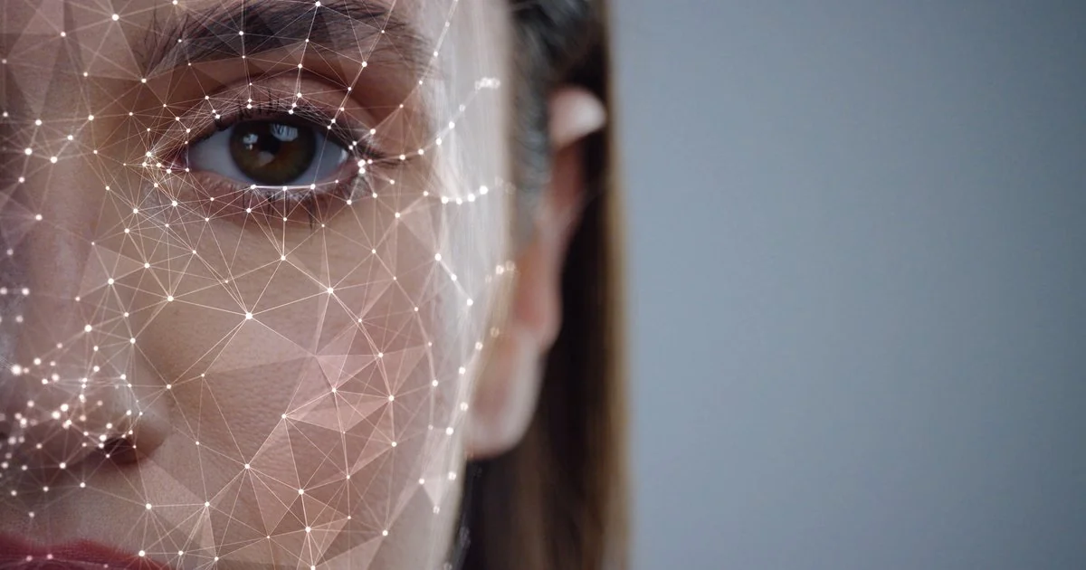
THANK YOU
slide is from google search

